Slide 1
Pre-lab Questions

Slide 2
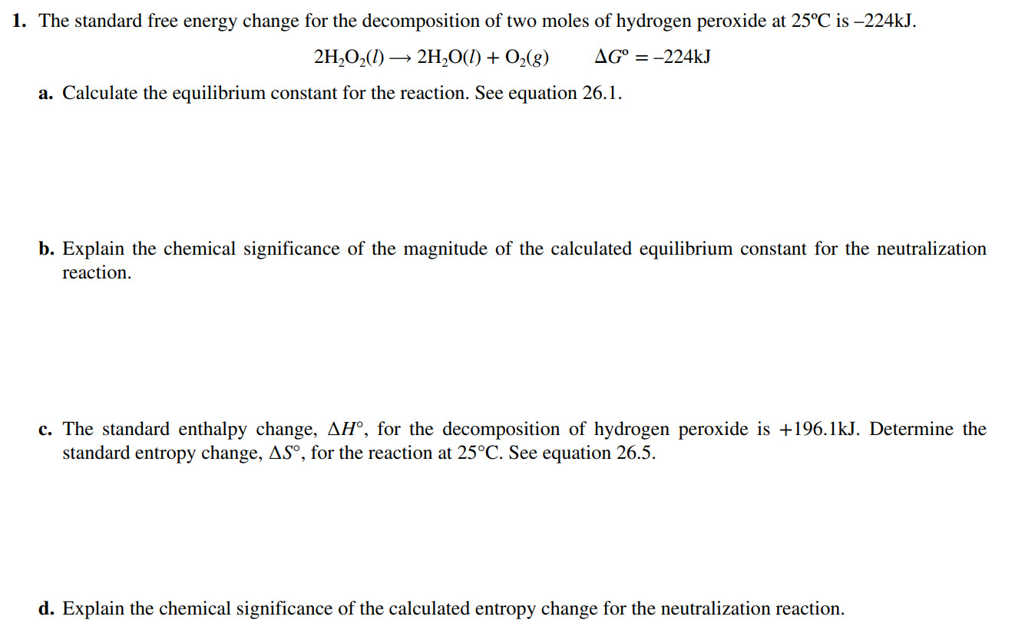
(8 points)

Slide 3
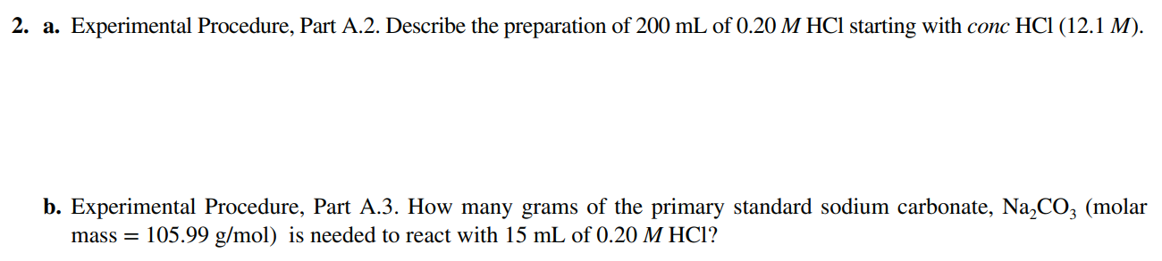
(4 points)

Slide 4
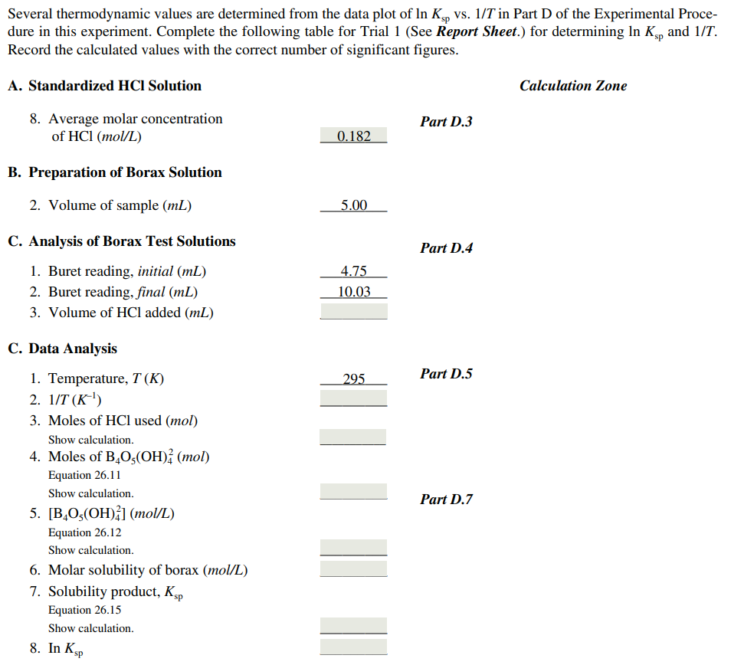
(8 points)

Slide 5
Laboratory Reports
Use the format shown in manual(page 24~26).
+ Discussion(Summary/Assessing the result/Conclusion) should be included here.

Slide 6
Post-lab Questions
(3 points each, maximum 20 points)

Slide 7
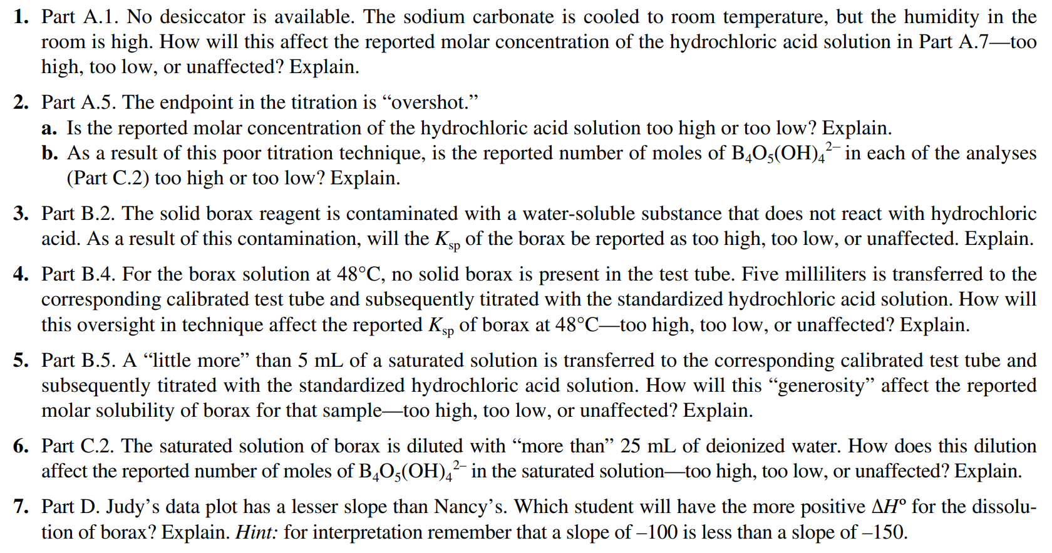

Slide 8
Textbook Content for Exp. 6

Slide 9
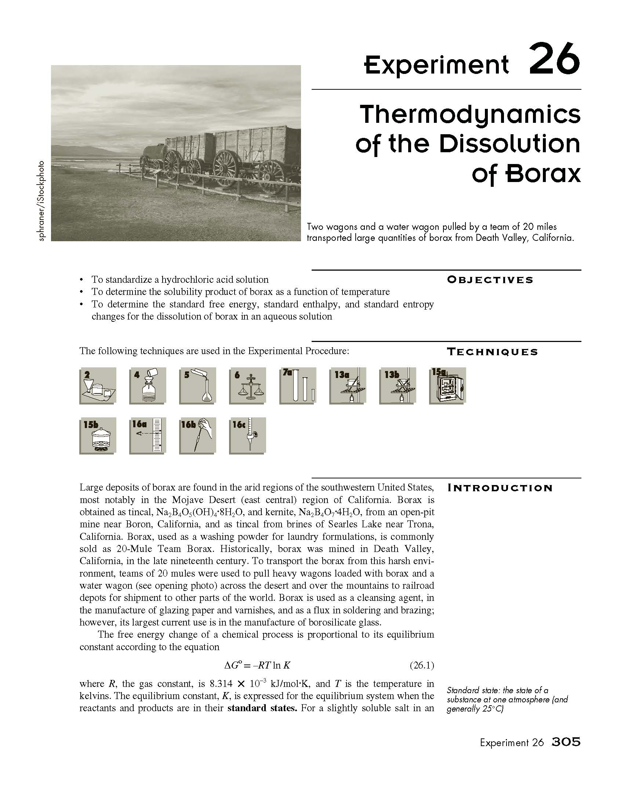
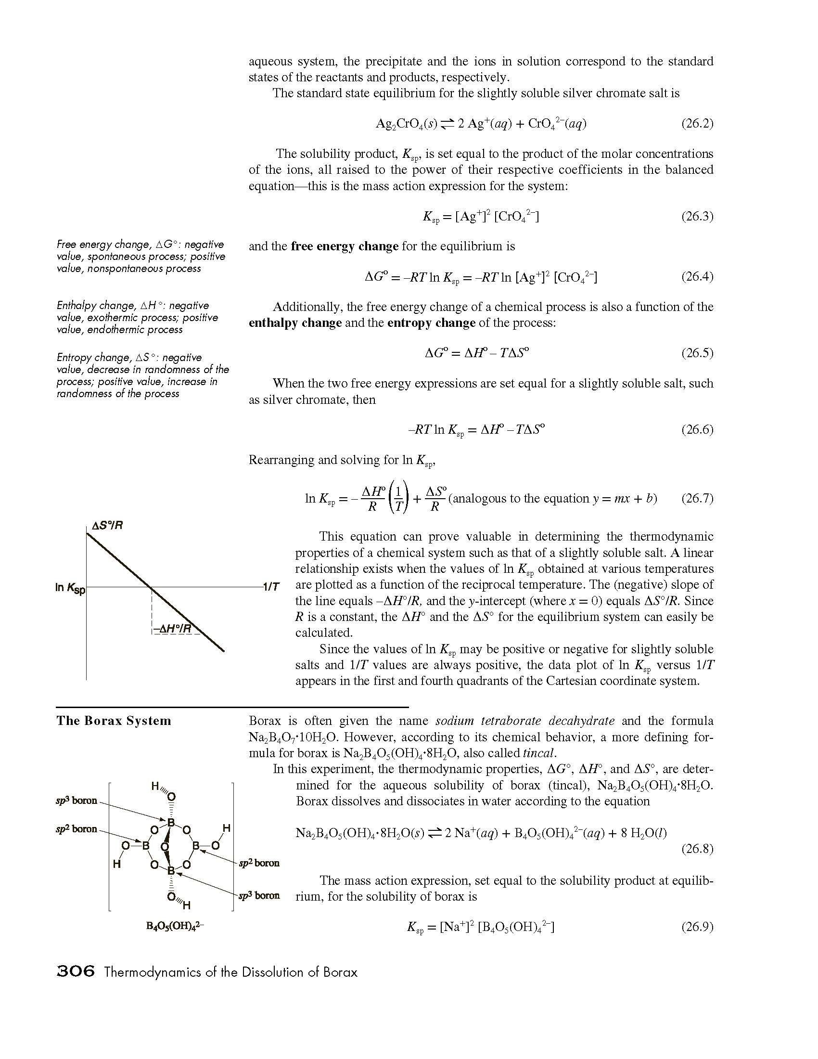

Slide 10
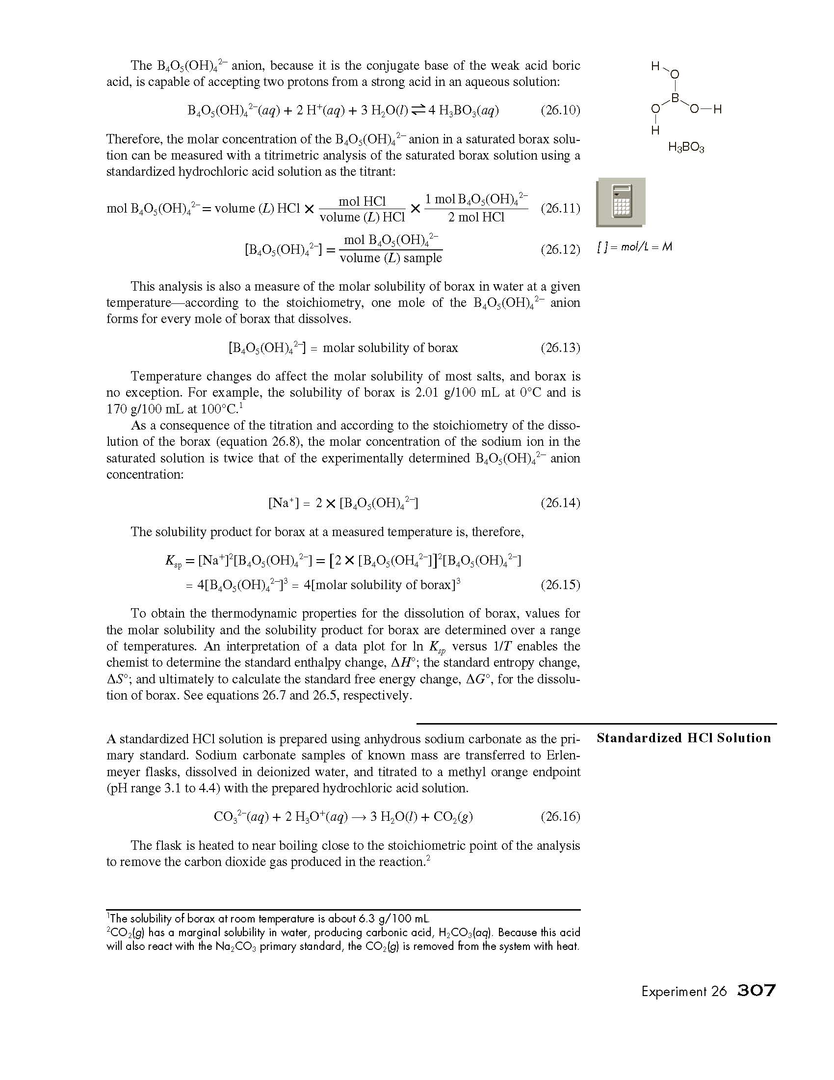
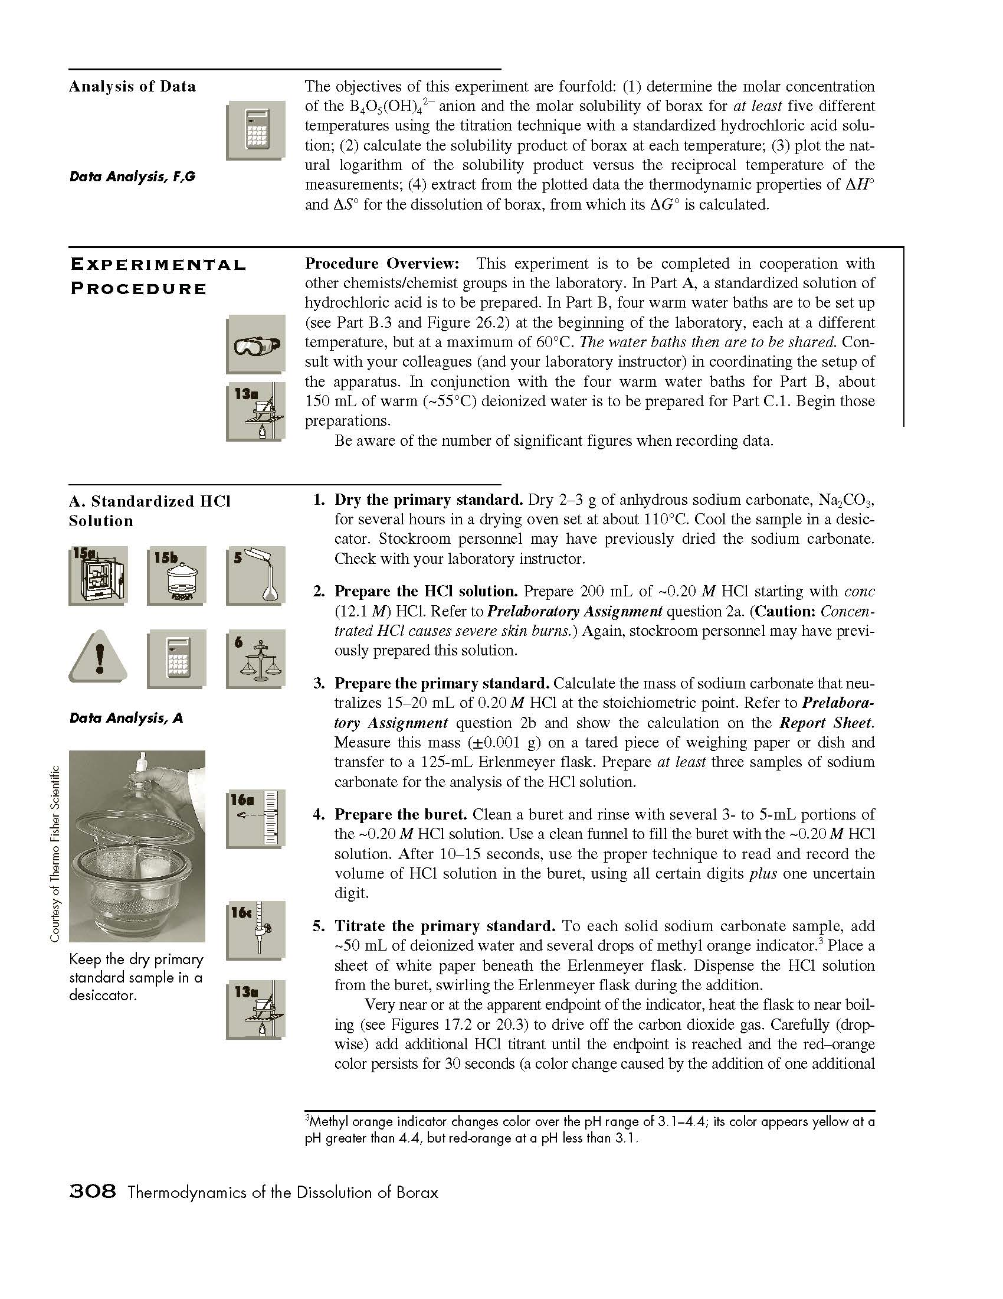

Slide 11
